Slide 1


Social Buzz

Slide 2


Today's agenda
Project recap
Problem
The Analytics team
Process
Insights
Summary

Slide 3

kkkkkk
Social Buzz is a fast growing technology unicorn that need to adapt quickly to it’s global scale.
Accenture has begun a 3 month POC focusing on these tasks:
An audit Social Buzz’s big data practice
Recommendation for a successful IPO
Analysis to find Social Buzz’s top 5 most popular categories of content
Project Recap

Slide 4


Problem
Over 100000 posts per day
36,500,000 pieces of content per year
How to capitalize on it when there is so much?
⇒ Analysis to find Social Buzz’s top 5 most popular categories of content

Slide 5



Andrew Fleming
Chief Technical Architect
The Analytics team
Marcus Rompton
Senior Principle
Selina Vu
Data Analyst

Slide 6
Process
1
Data Understanding
2
Data Cleaning
3
Data Modeling
4
Data Analysis
5
Uncover Insights

Slide 7
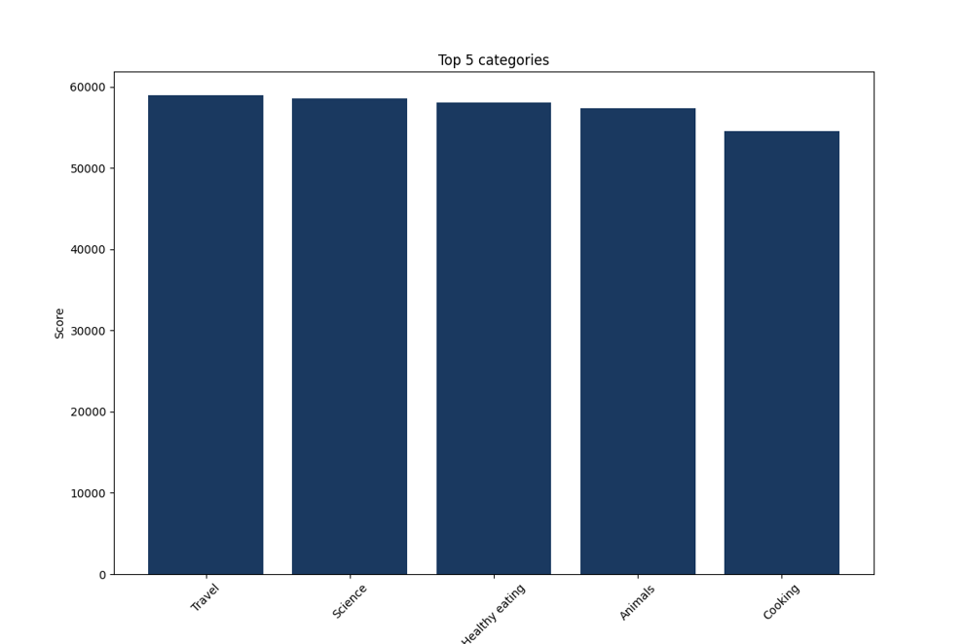

Insights
The dataset has a total of 16 different contents
The 5 most viewed by users are: Travel, Science, Healthy Eating, Animal, and Cooking
The highest is Travel

Slide 8
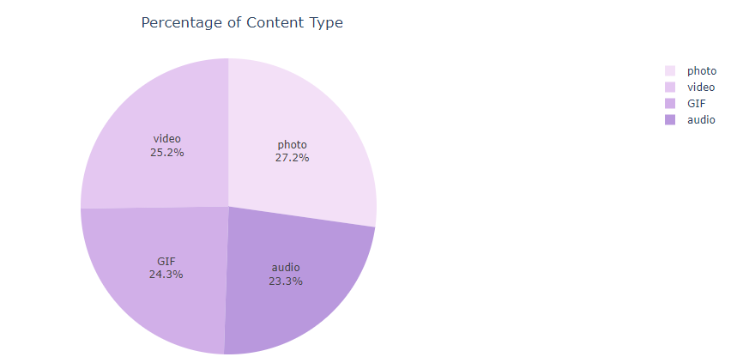
4 post content types: photo, video, audio, and GIF.
The photo accounts for the highest percentage (27.2%)

Slide 9
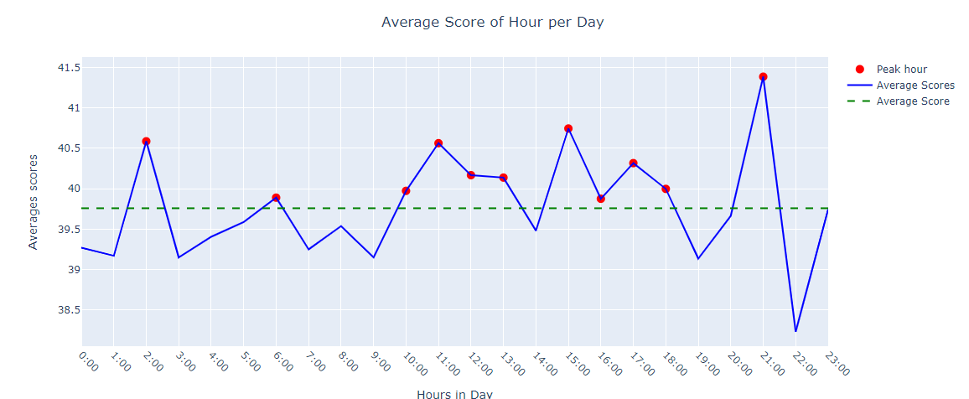
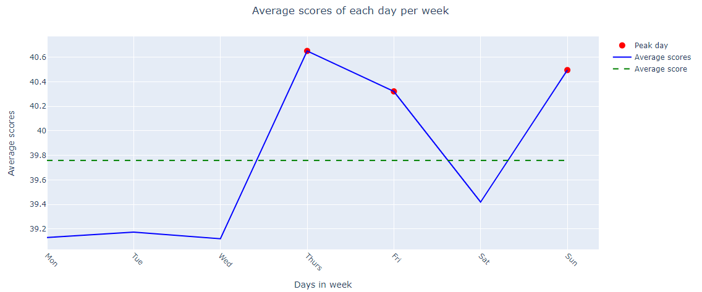
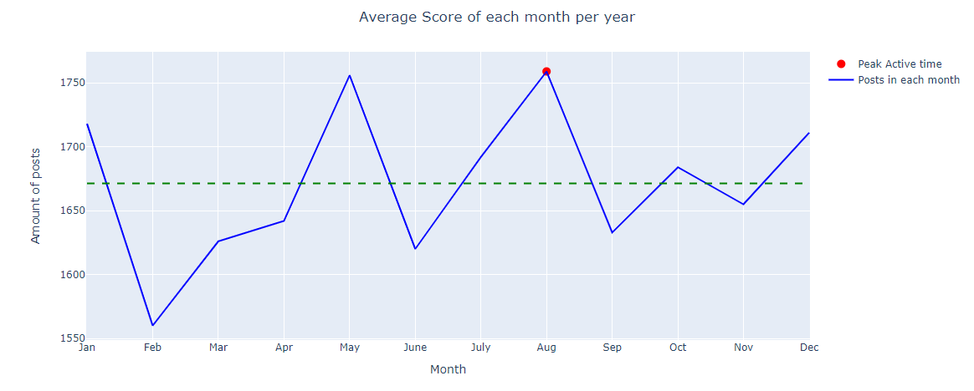

Slide 10
Peak engagement hours on the platform are at 2:00 a.m., 11:00 a.m., 3:00 p.m. and 9:00pm. Here are four optimal times to post and engage with content
Thursday, Friday, and Sunday are the days with the highest engagement
After analyzing the data, August is the month with the highest number of posts
Summary

Slide 11

Thank you!
ANY QUESTIONS?

